Slide 1

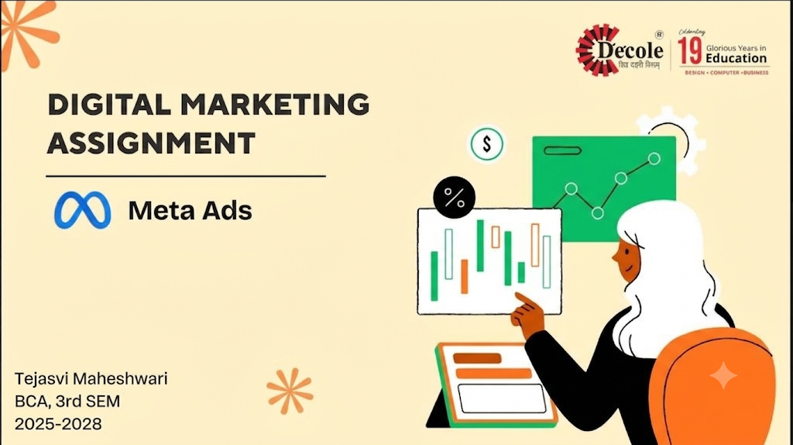

Slide 2

Digital Marketing
Assignment Report
--------------------------------------------------------------------------------------------------------------------------------------------------------------------------------
ASSIGNMENT FOLIO
Assignment Folio of
Digital Marketing
Submitted to
Dezyne École College
Toward Digital Marketing
By
BCA
3rd Semester
Tejasvi Maheshwari
Dezyne École College
106/10, Civil Lines, Ajmer
www.dezyneecole.com
2026-2027
--------------------------------------------------------------------------------------------------------------------------------------------------------------------------------

Slide 3
Digital Marketing
Acknowledgement
--------------------------------------------------------------------------------------------------------------------------------------------------------------------------------
ASSIGNMENT FOLIO
We take this opportunity to express our sincere gratitude to Dezyne École College for providing us with the knowledge,
resources, and guidance essential to the successful completion of this project.
Our deepest thanks to our respected Principal, Dr. Vinita Mathur, for her visionary leadership and continuous encouragement.
Her commitment to academic excellence and student growth has been a constant source of motivation and pride.
We are equally thankful to all our faculty members for their consistent support, expert advice, and valuable insights that
shaped our learning and helped us achieve this milestone.
Lastly, we extend heartfelt thanks to everyone who directly or indirectly contributed to the success of this project.
We are proud to be part of Dezyne École College, an institution that truly nurtures professionalism, innovation, and purpose.
With sincere appreciation,
Tejasvi Maheshwari
Department – BCA
Dezyne École College, Ajmer
--------------------------------------------------------------------------------------------------------------------------------------------------------------------------------

Slide 4
Digital Marketing
Case Study
--------------------------------------------------------------------------------------------------------------------------------------------------------------------------------
ASSIGNMENT FOLIO
Objective:
Increase Instagram Profile Visits, Boost Brand Awareness, Grow Followers Organically, Increase Engagement Rate & Improve Content Reach.
1. Traffic Campaign Objective
Selected the “Traffic” objective in Meta Ads Manager to drive Instagram profile visits.
2. Audience Targeting
Targeted users based on age, interests, behavior, and location.
3. Engaging Creative Content
Used eye-catching Reels, carousel posts, and strong captions.
4. Call-to-Action Button
Used “Visit Instagram Profile” to direct users instantly.
5. Performance Tracking
Monitored metrics like CTR, Profile Visits, CPC, and Engagement Rate.
--------------------------------------------------------------------------------------------------------------------------------------------------------------------------------

Slide 5
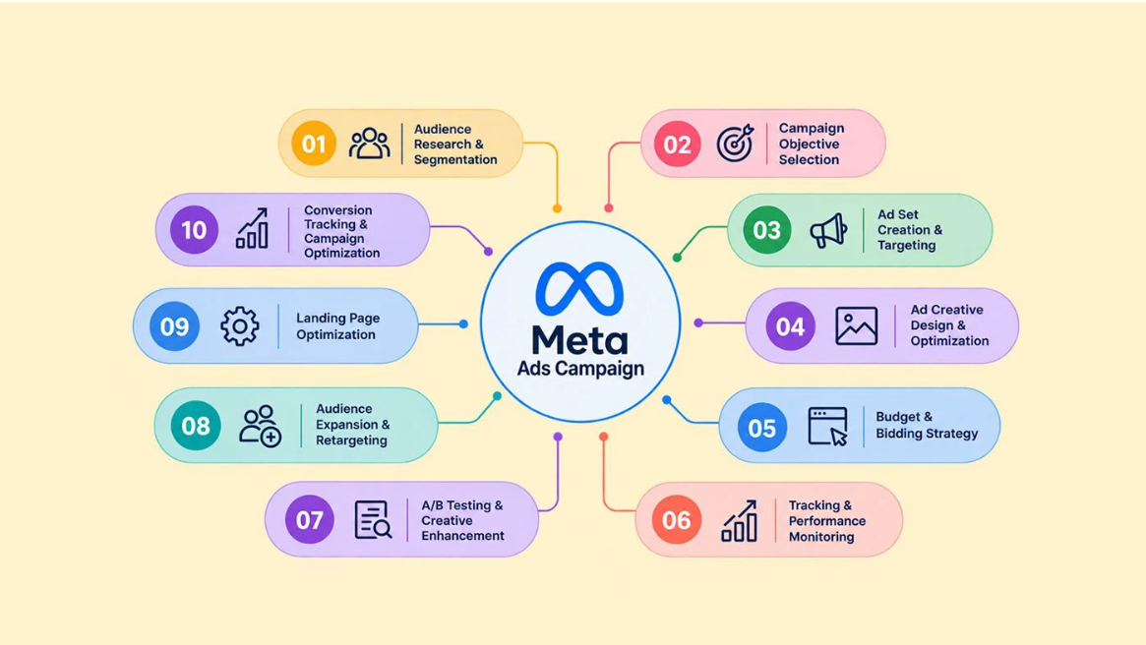

Slide 6


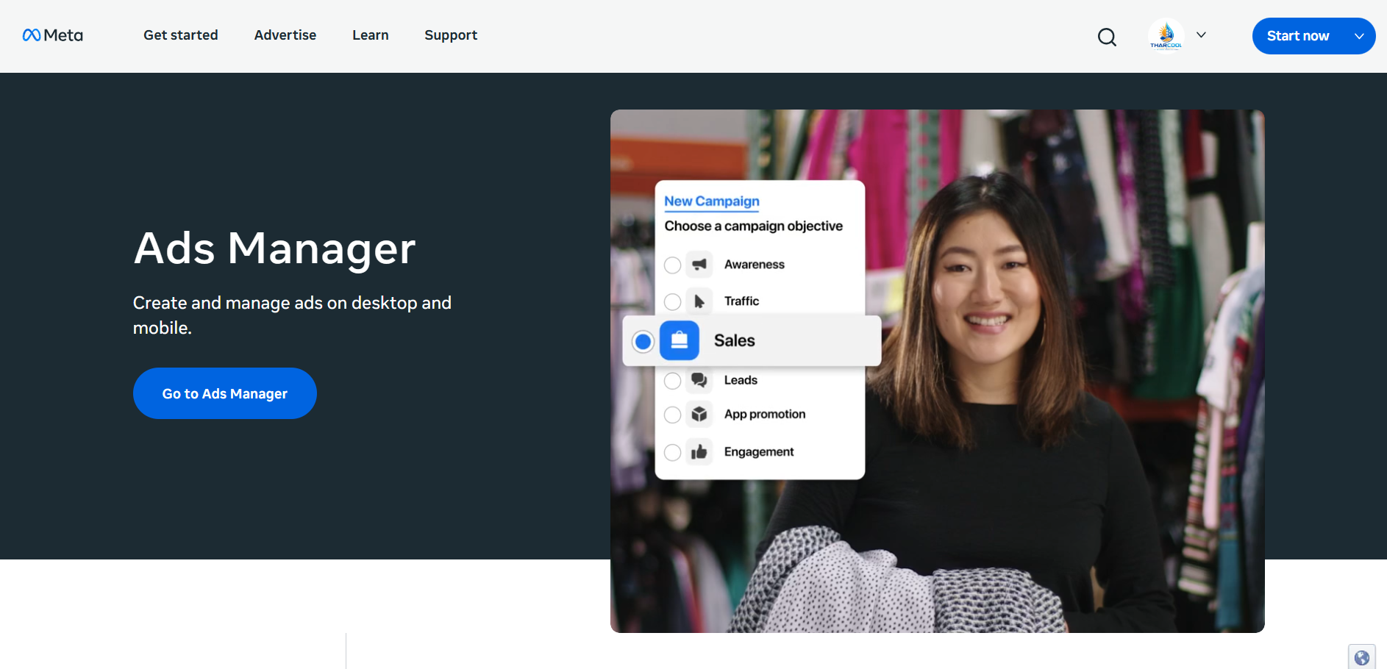
Meta Ads Platform-Overview

Slide 7
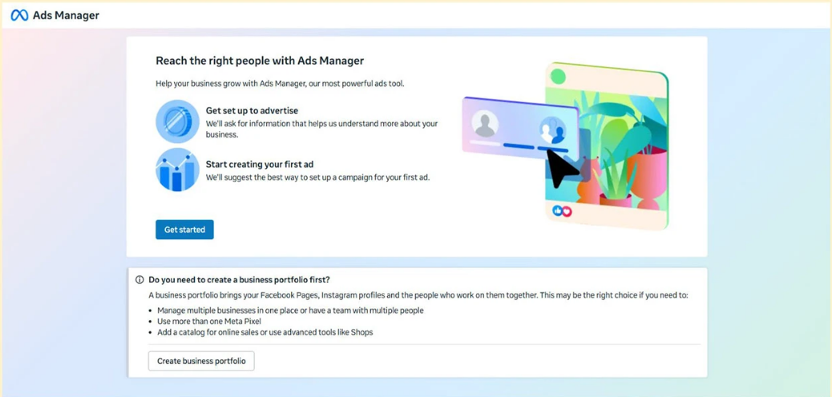
Reach the Right People

Slide 8
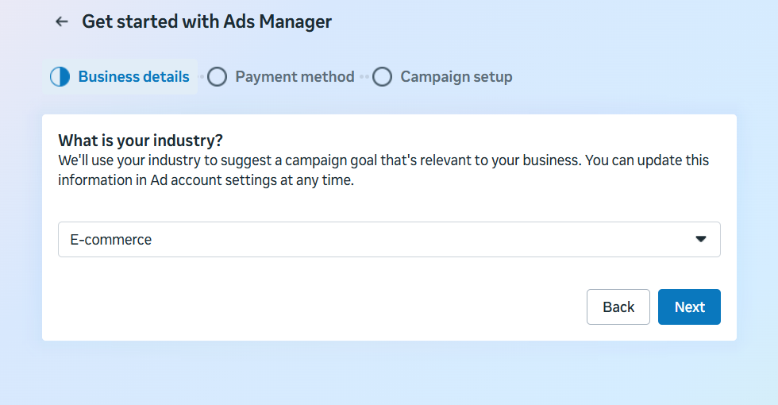
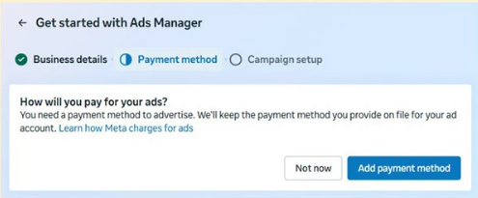
Get Started with Ads manager

Slide 9
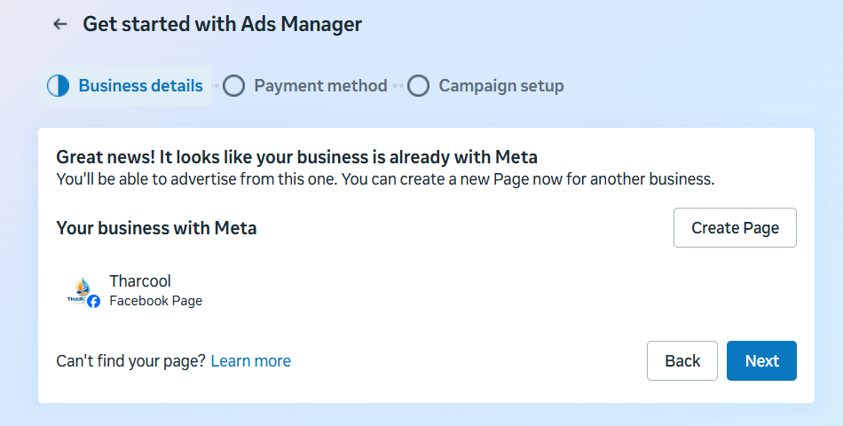
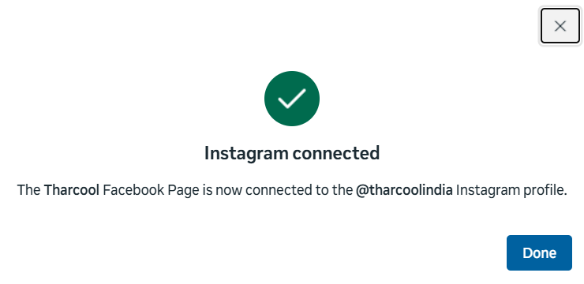
Instagram Connection

Slide 10
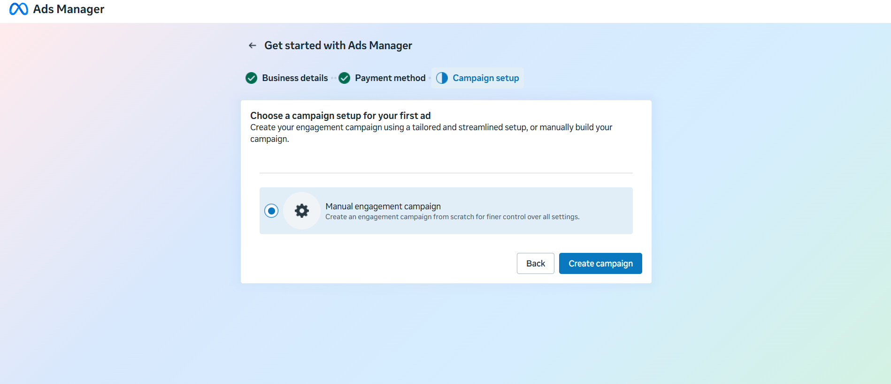
Campaign Setup – Manual Traffic Campaign

Slide 11
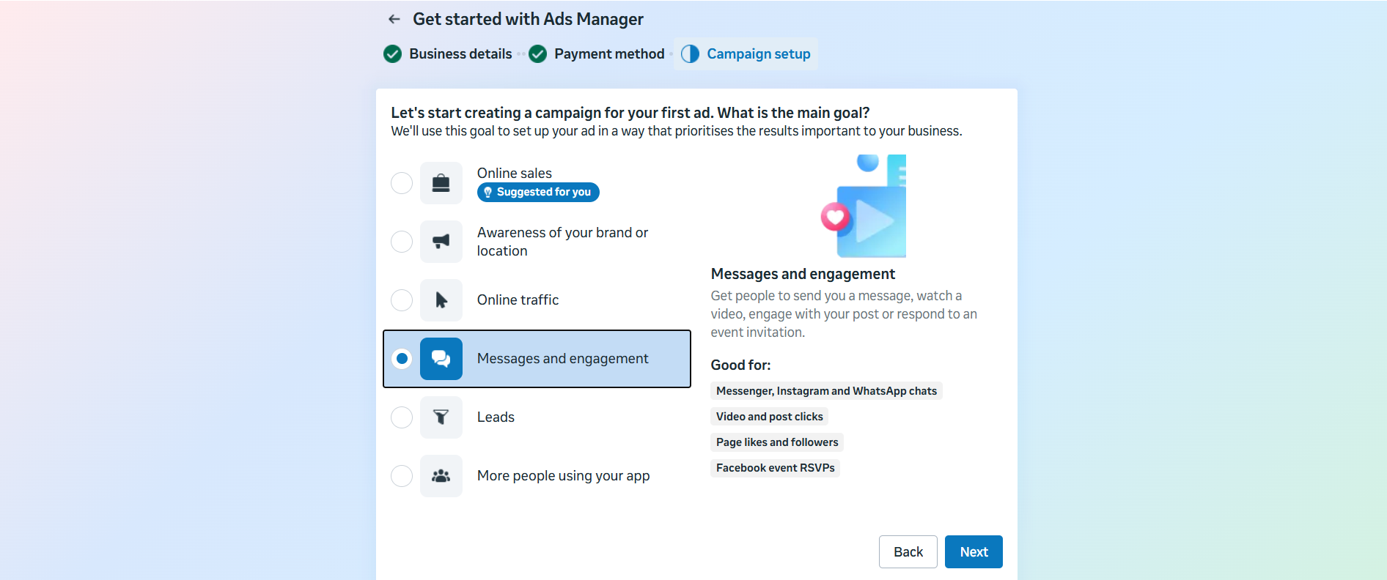
Campaign objective Selection – Online Traffic

Slide 12
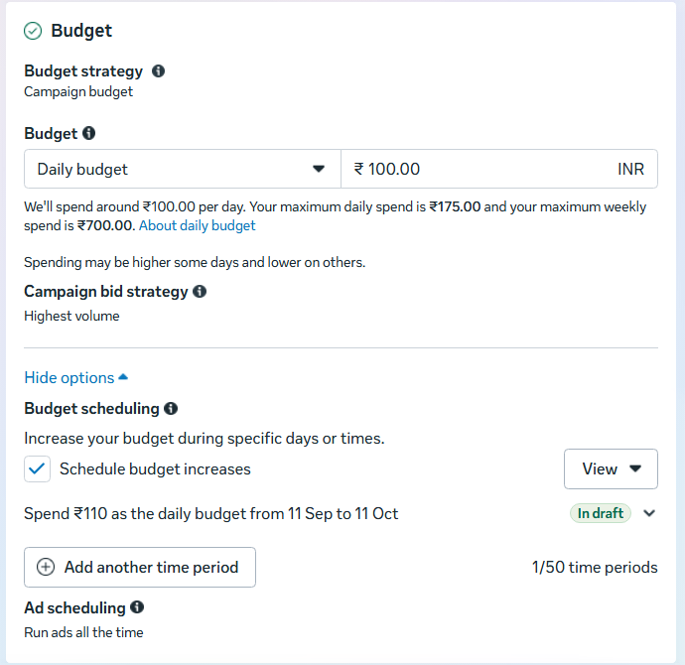
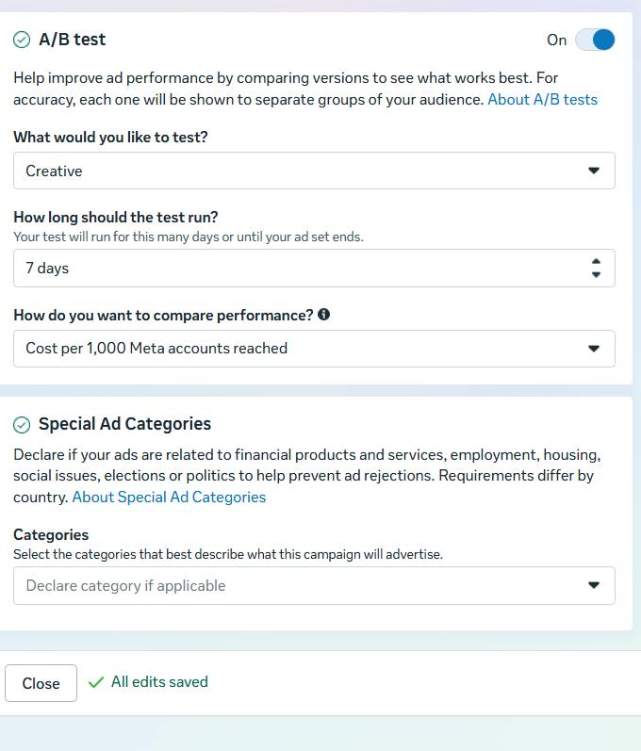
Budget Strategy & Bidding Selection

Slide 13
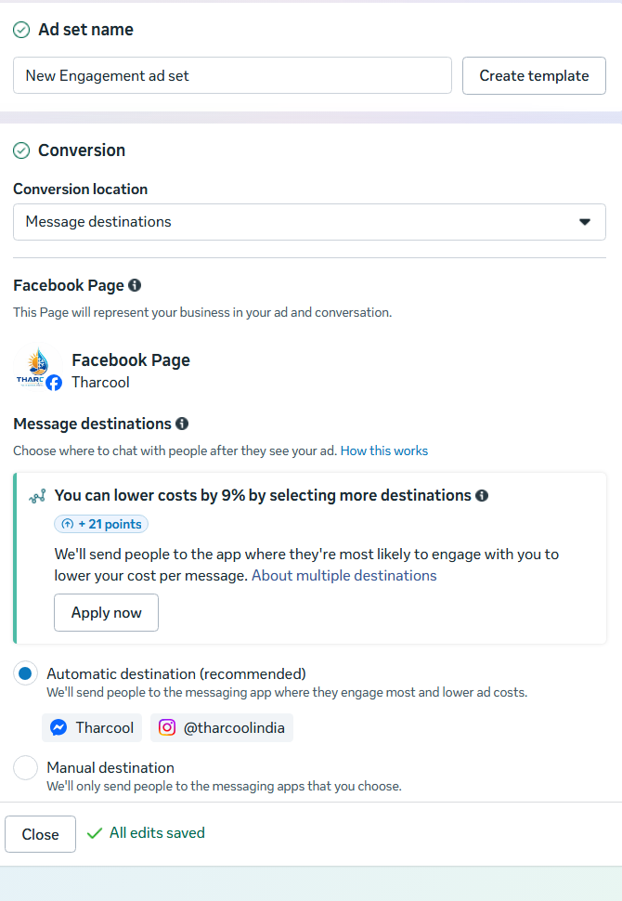
Ad Set Configuration – Profile Traffic Stragety

Slide 14
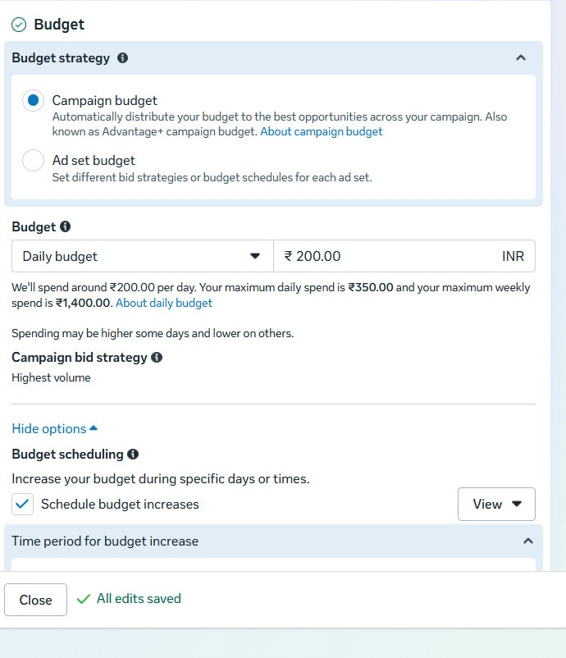
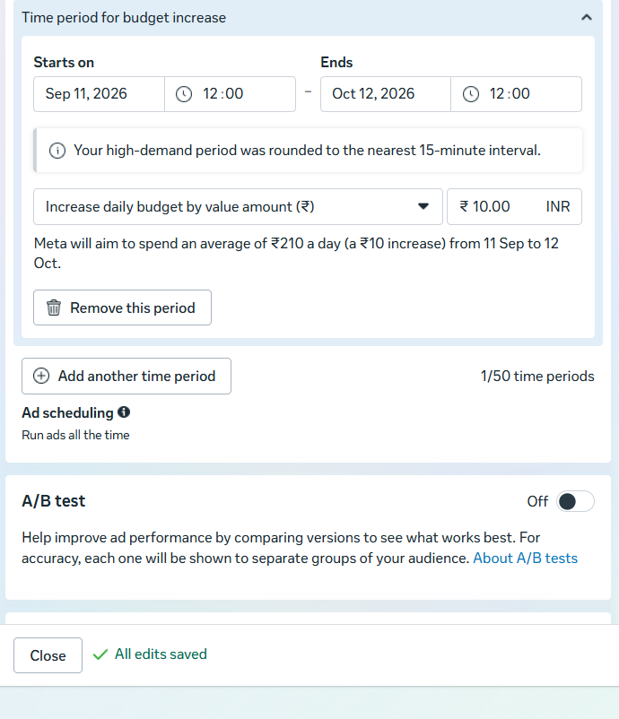
Budget Strategy & Bidding Selection

Slide 15
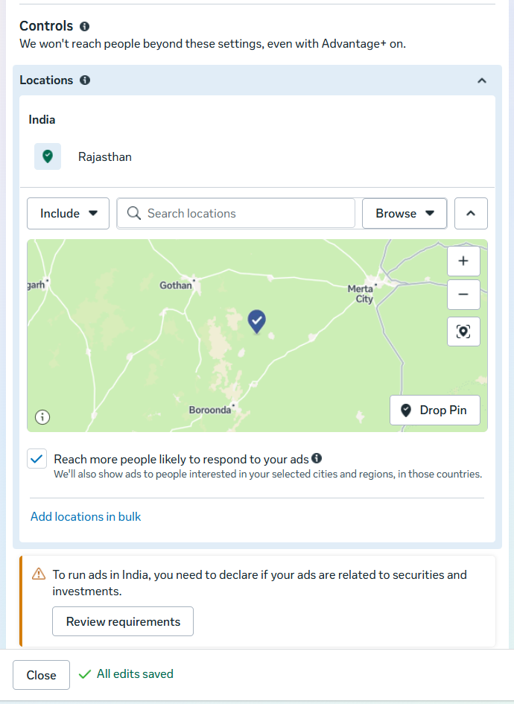
Location Targeting

Slide 16
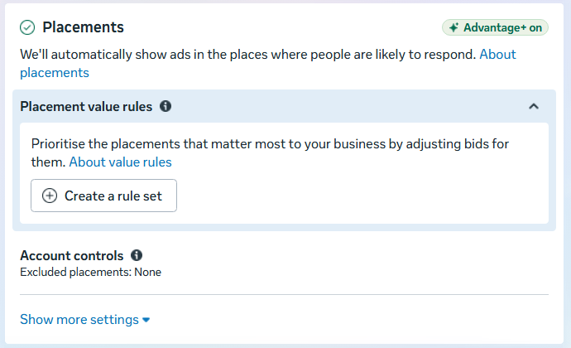
Ad Placement Strategy

Slide 17
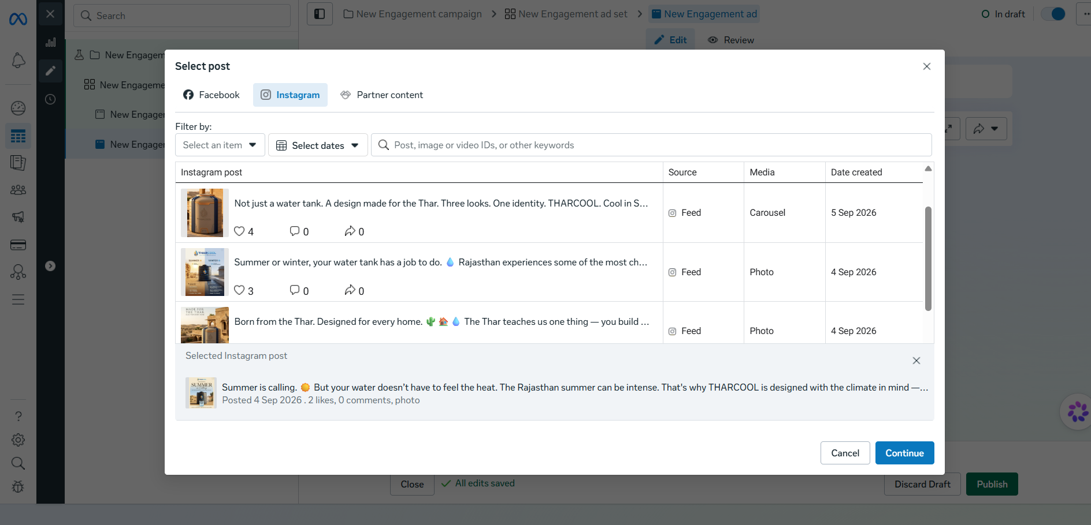
Select Post

Slide 18
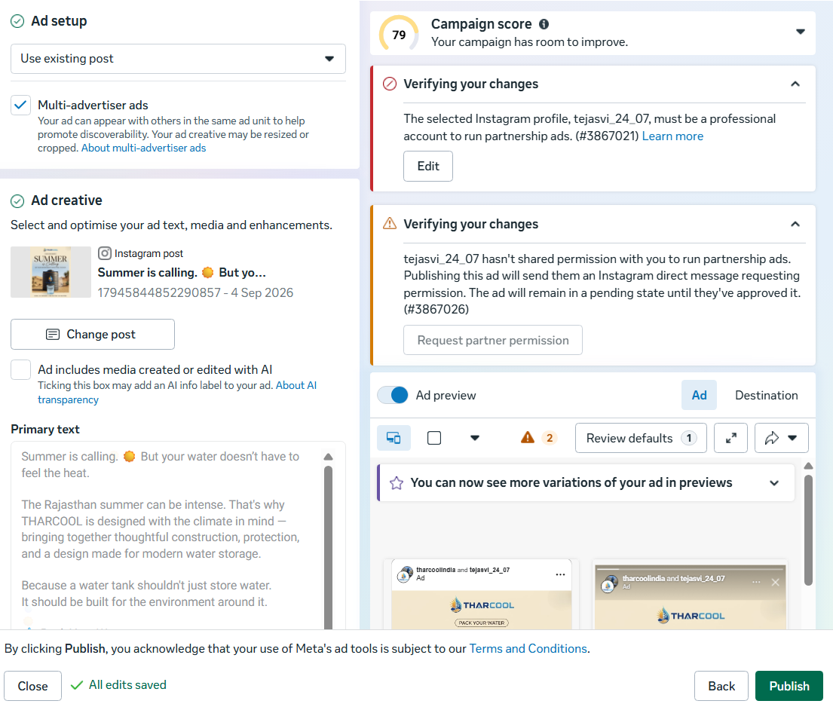
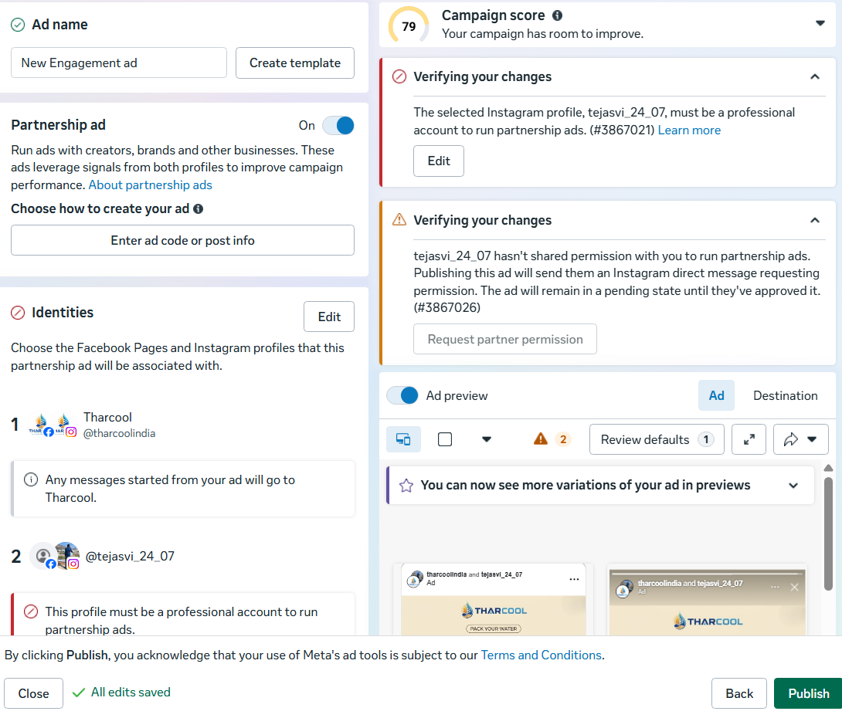
Ad Campaign Setup

Slide 19
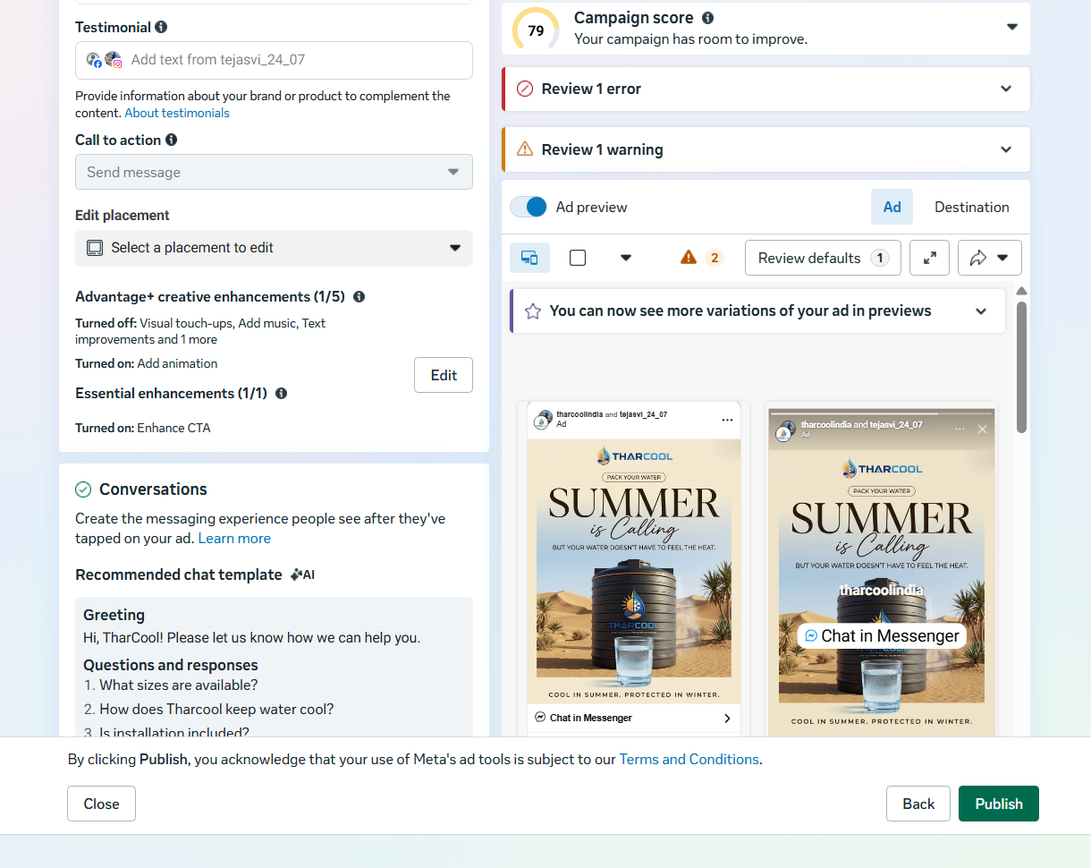
Edit Placement

Slide 20
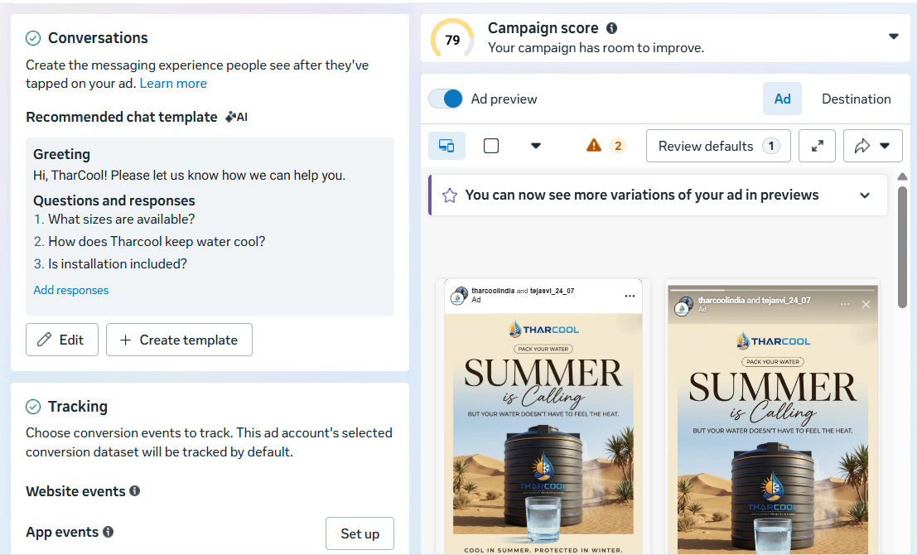
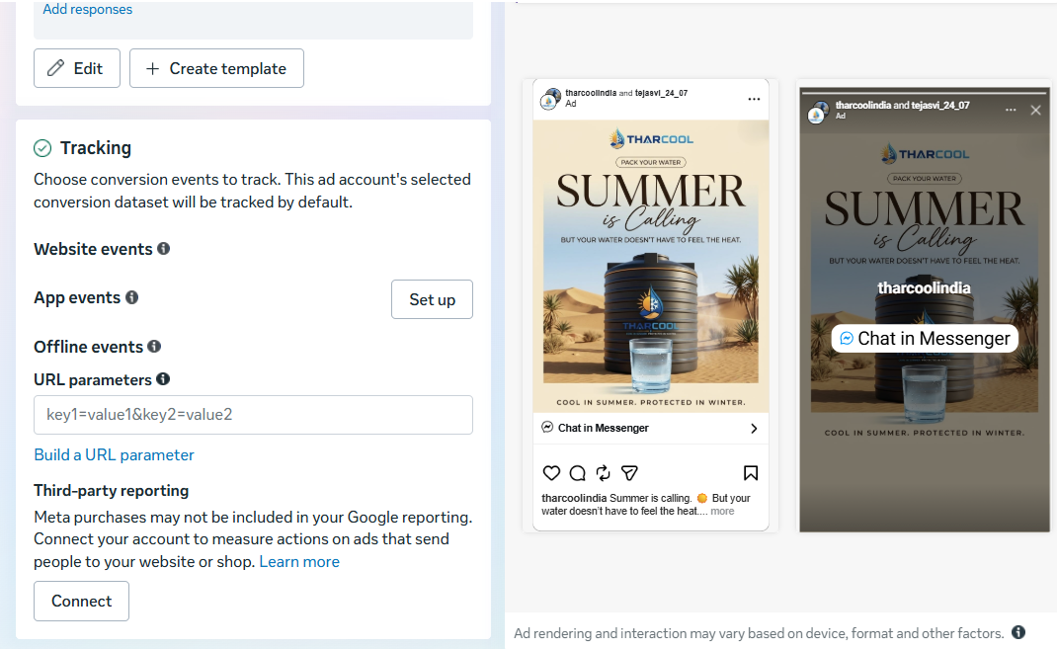
Conversation & Tracking

Slide 21
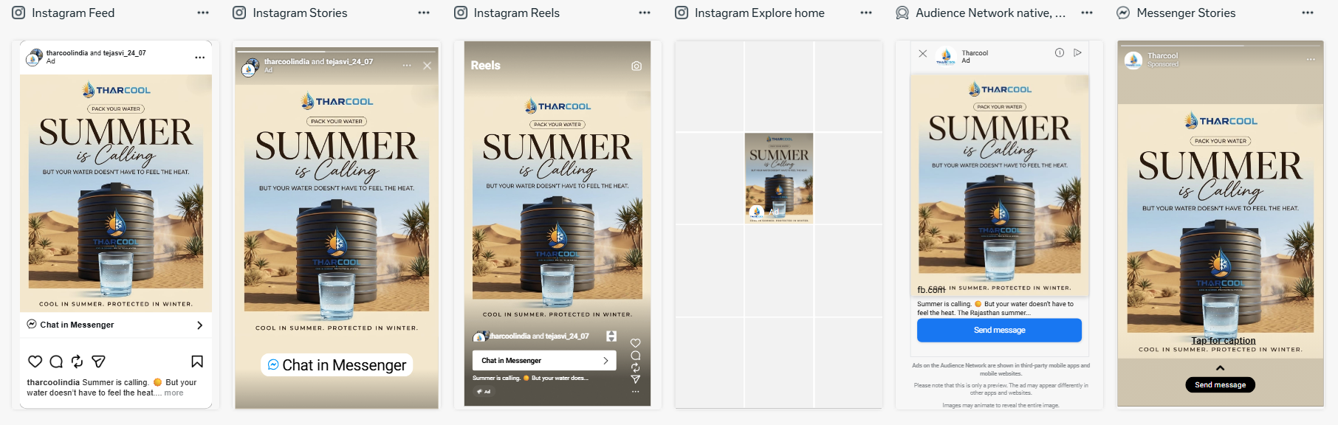
Final Ad Preview

Slide 22


